Slide 1
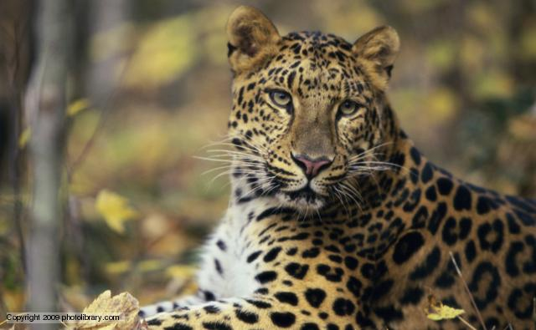
Leopard News
2017-2018 School Year
Oct 30 – Nov 3

Slide 2

Sports- Volleyball
Smith vs. Eastern Hills MS
7th grade away and 8th grade home
Tickets cost $2
B team starts at 5:30pm
A team starts at 6:30pm

Slide 3

Sports- Football
Smith vs. Eastern Hills MS Oct 31st
7th grade at Ellison HS
8th grade at Eastern Hills MS
Tickets cost $2
B team starts at 5:30pm
A team starts at 6:30pm

Slide 4

8th grade Dance:
Friday, Nov 3rd starting at 3:30 to 5pm
Tickets can be purchased during your math class
Tickets cost $2 in advance and $3 at the dance

Slide 5
6th grade Dance:
Please remember to stay within the KISD dress code.

Slide 6
Coding Club:
There will be a coding club meeting this Thursday, Oct 26th starting at 3:15pm.

Slide 7
Rubik’s Cube Wannabe’s:
During the month of November, Mrs. Cox will be hosting a get together to work on how to solve the Rubik’s Cube.
During 7th grade lunch, grab your lunch and go to room 618
Tournament will be held at the end of the month.

Slide 8
Chess Club:
If you are interested in playing chess, come to our first meeting this Friday, Nov 3rd in room 713 from 3:05 to 4pm.
After that the meetings will be Mondays and Fridays from 3:05 to 4pm.
If you have any questions, please see Mr. Cranford in room 713

Slide 9
Student Council:
Interested in an opportunity to develop leadership qualities by organizing and carrying out school activities and service projects?
Student council maybe the right club for you!
Come for a quick meeting this Thursday, Nov 2nd in room 710 or see Ms. Brown or Mr. Fulcher

Slide 10
Theatre Club:
Do you love to perform?
Maybe you want to learn?
Come join the Leopards Theatre Club, first meeting will be Wednesday, Nov 1st from 3:15pm to 4:15pm in room 200
If you have questions, please see Mr. Glynn in room 706

Slide 11
NJHS:
Attention NJHS members, we will have our monthly meeting Wednesday, Nov 1 after school in room 613 at 3:15pm

Slide 12
Upcoming Events:
Volleyball game Monday, Nov 6th against Liberty Hill MS
Football game Tuesday, Nov 7th against Liberty Hill MS with 7th grade at Ellison High School

Slide 13
Upcoming Events:
Tuesday, Nov 7th come out to McAllisters for a charitea event
From 5pm to 10pm
10% of sales will be donated to Smith Middle School Avid

Slide 14
IDs:
Students your ID must be worn around your neck with the appropriate colored lanyard.
  6th grade- Yellow
  7th grade- Red
  8th grade- Green
If you lose your ID you can purchase a replacement for $5.

Slide 15
Announcements-
Students remember to wear your IDs and make sure that they are out and visible at all times.
Students remember that backpacks are not allowed in the classrooms.

Slide 16
Announcements-
Students check the lost and found located on the ramp to the stage.

