Slide 1
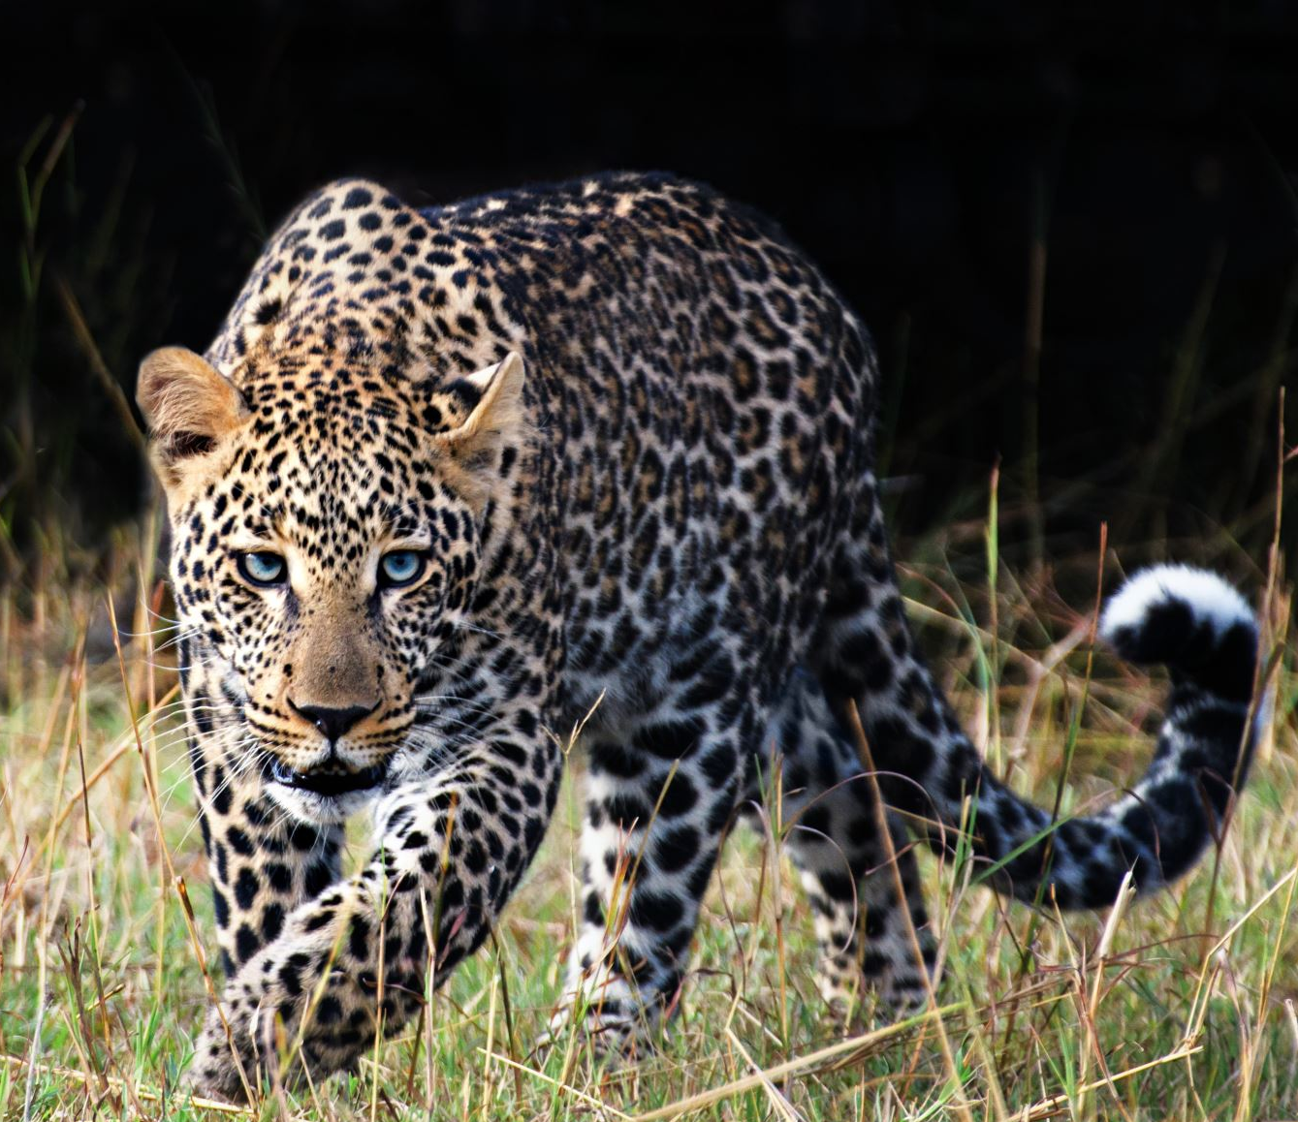
LEOPARD EXPECTATIONS
2023-2024
Notes:
Good morning Leopards, this is Dr. Wolf your campus Principal and I would like to Welcome you back to Smith Middle School.
As we start the second semester it is a good time to revisit our expectations in anticipation of a great rest of the year.

Slide 2

LEOPARD
VALUES
DETERMINATION
INTEGRITY
RESPECT
Notes:
These are our values at SMS and if you follow these you will be successful.
Determination – set you goals for both in and out of the classroom and set your steps to reach them. Then be determined to success and put in the “HARD WORK” to reach those goals.
Integrity – this is doing what is right whether anyone is watching or not. This is choosing to be a good person even when it doesn’t seem like it will benefit you.
Respect – showing respect to all those around you, treating others the way you would want to be treated.

Slide 3
LEOPARD MOTTO
HARD WORK
PAYS OFF!!
Notes:
At SMS we believe that “HARD WORK, PAYS OFF” and we have already seen a lot this school year. We have been able to recognize honor roll students from the first nine weeks, celebrate district championships, and celebrate other students' individual achievements.

Slide 4
MORNING ARRIVAL
Breakfast is available from 7:30 am to 7:55 am
Report directly to breakfast or your 1st period class
DO NOT ROAM THE HALLWAYS!
Notes:
You must receive permission or a pass from your first period teacher if you need to go anywhere else.

Slide 5
Student ID’s
ID’s are mandatory
No alterations (covering pictures or name)
Must be worn around the neck

Slide 6
DRESS CODE
Dress code is in accordance with KISD Student Code of Conduct

Slide 7
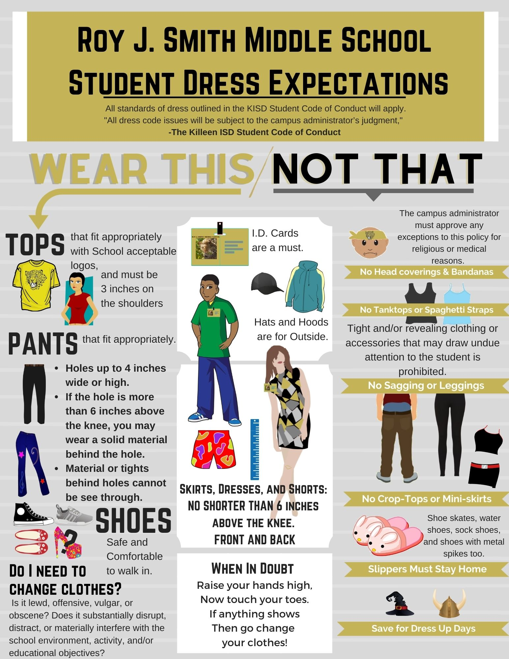
Notes:
Add a box of examples of what not to be worn. (PJ Pants, Short Skirts or Shorts, Blankets, Hoodies, Hats, Sunglasses)

Slide 8
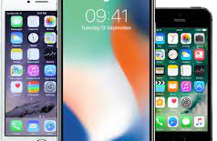
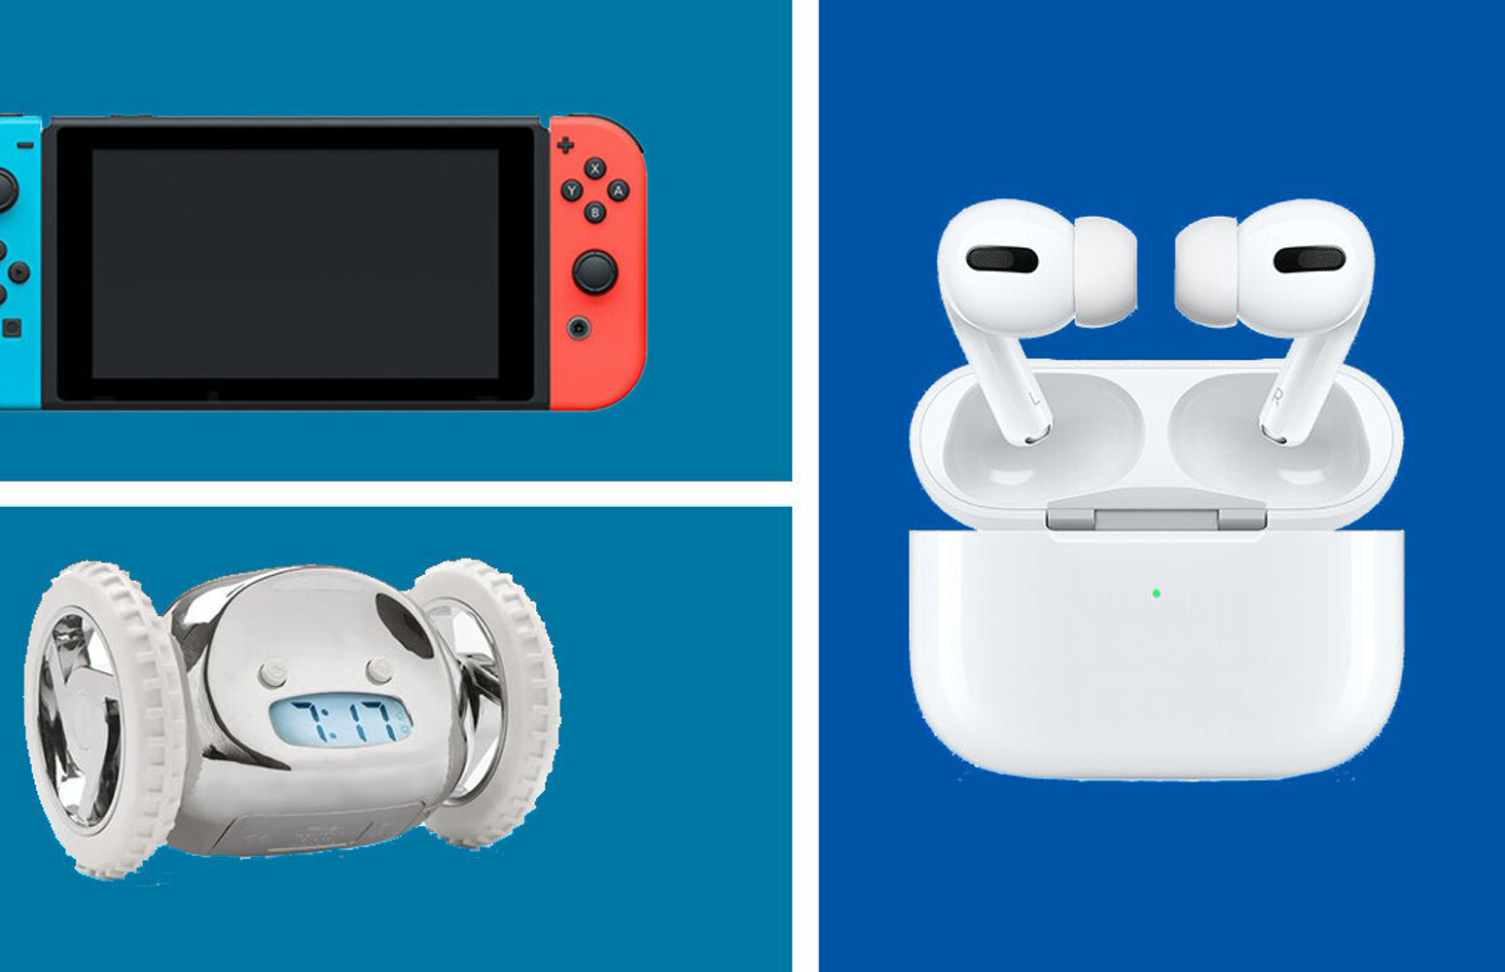

ELECTRONIC DEVICES
Electronic devices are not allowed to be used on campus (including hallways) unless given permission.
Devices will be confiscated by staff.

Slide 9
DISCIPLINE
TYPE 2 VIOLATIONS
  No ID
  Tardy
  Electronic Violation
  Dress Code Violation
TYPE 2 VIOLATION CONSEQUENCES (EVERY 4TH OFFENSE)
  4 – Lunch Detention
  8 – Saturday Detention (2 HOURS)
  12 – Saturday Detention (4 HOURS)
  16 or More - ISS

Slide 10
DISCIPLINE
Student Code of Conduct must be followed at all times
Assistant Principals handle discipline issues
  6th Grade Mr. Rhiner
  7th Grade Ms. Carlson
  8th Grade Vacancy
Notes:
Discipline
All students are required to follow the KISD Student Code of Conduct
APs 6th, 7th, 8th, however any AP can worker with any student.

Slide 11
DISCIPLINE
All faculty and staff have a right to correct a student’s behavior
DO WHAT IS RIGHT! - INTEGRITY

Slide 12
Hallways and Passing Period
1. Keep Noise to a minimum
2. Do not loiter in hallway/restroom
3. No devices in hallway (Items will be confiscated and receive Type 2 Violations)
4. Walk on the right side of the hallway
5. No horseplay (pushing, shoving, play fighting, running, screaming, etc.)

Slide 13
LUNCH PERIOD
TEACHERS WILL BRING YOU TO LUNCH AND SEAT YOU
DO NOT MOVE YOUR CHAIR
IF YOU HAVE LUNCH DETENTION REPORT DIRECTLY TO STAGE
ADMINISTRATOR WILL DISMISS YOUR TABLE TO GET IN LINE
MUST GET PERMISSION TO GET UP BY RAISING YOUR HAND
KEEP NOISE TO AN ACCEPTABLE LEVEL
CLEAN YOUR AREA AND THROW TRASH AWAY AS YOU EXIT THE CAFETERIA

Slide 14



LUNCH PROCEDURES

Slide 15
BUS DISMISSAL
Bus riders will report to the cafeteria at 3:25PM
Buses depart at 3:37PM

Slide 16
WALKERS, CAR RIDERS, BOYS & GIRLS CLUB
Dismissal bell rings at 3:30PM
Exit the nearest doors to your classroom and walk around to your pickup point

Slide 17
TUTORING & EXTRA CURRICULAR DISMISSAL
Activity bell rings at 3:37PM
Students MUST be in tutoring /practice location by that time
Notes:
Any student not in tutoring, club meeting, or practice by 3:37 pm will be directed to go out the nearest door. Students then must leave campus or report to Boys & Girls Club located at the cafeteria doors.

Slide 18
LEOPARD MOTTO
HARD WORK
PAYS OFF!
Notes:
Leopards, I know that if you follow these expectations and our SMS Values your HARD WORK will PAY OFF!
I look forward to seeing all the success that our students will have during the 2nd semester.

