Slide 1
HHHS crash Credit Recovery PROGRAM
Parent presentation
September 5, 2023

Slide 2

Intervention Support Team
Sherce Hampton- Social Emotional Learning Specialist
Danny Cranford- English Language Arts Teacher
Laura House- Social Studies Teacher/Social Emotional Learning
Todd Ritchie- Social Studies Teacher
Cathy Tollett- Math Teacher

Slide 3
Intervention supports
Credit Recovery
Tutoring
College Prep Courses for Seniors
STAAR EOC Remediation
Mentoring

Slide 4
Grade Classification by Credits
9th Grade 0-5.5 Credits
10th Grade 6-11.5 Credits
11th Grade 12-16.5 Credits
12th Grade 17 Credits or More (Must be a 4th Year Student)
Students can earn up to 7 credits per school year if enrolled in all face-to-face classes.

Slide 5
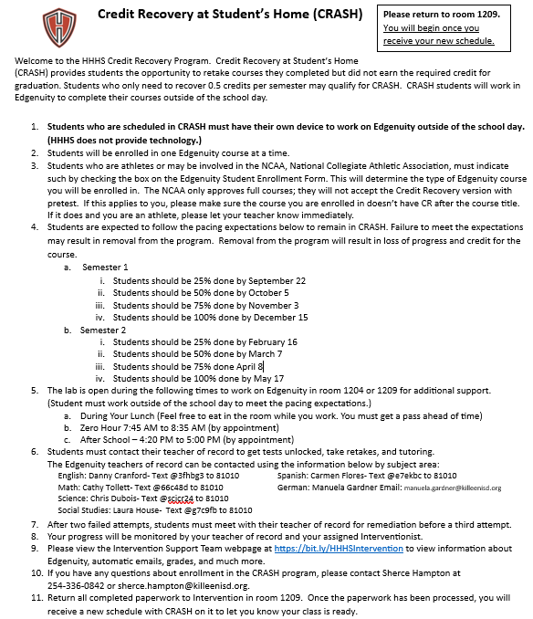

Slide 6

CRASH Expectations Overview
NCAA- National Collegiate Athletic Association
Enrolled in one Class at a time
Additional lab opportunities by appointment:
Before School, During Lunch, After School
Must complete classes according to the plan or may be dropped from Credit Recovery
Must stay on task and comply with lab, HHHS, and District rules and policies
Students must have an electronic device to work on Edgenuity at home. (HHHS does not issue devices)

Slide 7
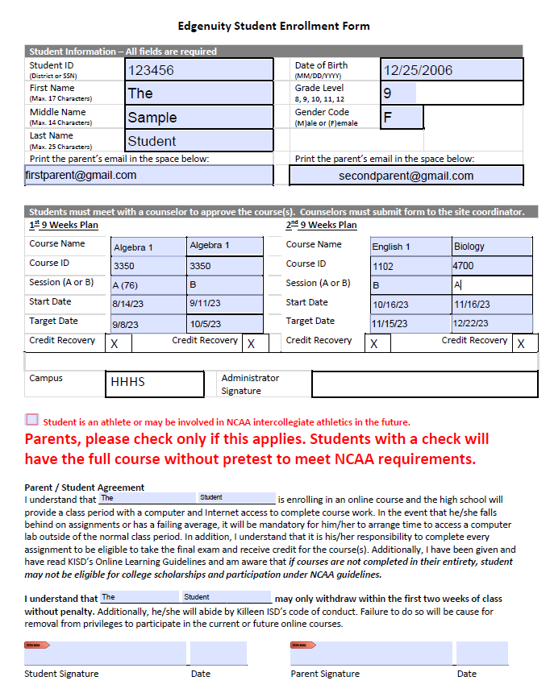
Edgenuity Enrollment Form
Parent must Check the Box if the student is an athlete or may be participate in NCAA
Must be turned in with parent signature to begin Courses
Parent email address in eschool system. Must update with registrar’s office
Target date = due date

Slide 8
Edgenuity
A Quiz occurs at the end of each lesson.
A Test occurs at the end of each unit and includes questions from each lesson in the unit.
An Exam occurs at the end of each course and includes questions from all lessons in the course.
Pretest mode moves the ten-question quiz to the beginning of each lesson and allows students to skip the instructional and assignment content for the lesson if students score 80% or above. Only courses ending -CR are in pretest mode. Courses in pretest mode do NOT meet NCAA eligibility and should not be used with athletes.
.

Slide 9
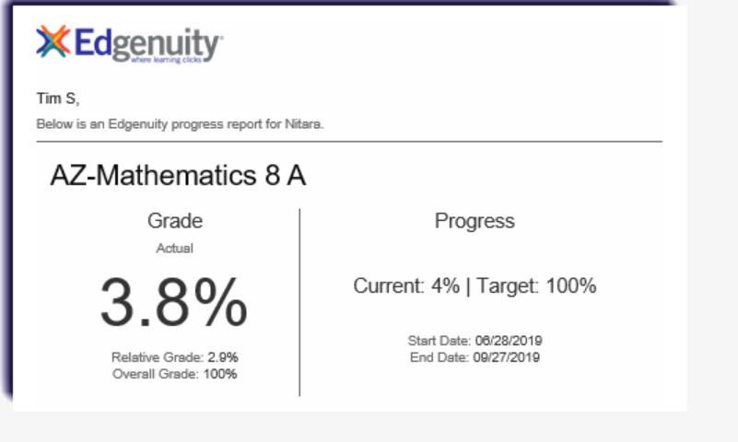
Automatic Weekly Progress emails/Grades
Actual Grade:
  This is the overall grade adjusted for progress if a student is behind.
Relative grade:
  Averages zeros for any work that is not completed.
  May be used for the semester grade if whether the student finished the course or not.
Overall Grade:
  When the student’s progress is 100% the Overall grade will be their final grade.. This will be a numeric Grade.
Grades will not be on report cards. Semester/final grades will be on the student’s transcript.

Slide 10
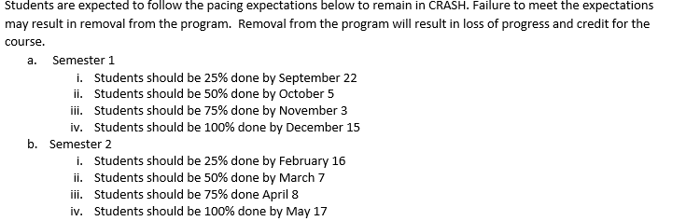
Pacing expectations

Slide 11
Interventionist
Monitor Students Progress
Encourage Students
Communicate with Student/Parent About Edgenuity Progress
Mentoring

Slide 12
Teacher of Record
Review and grade assignments
Monitor student progress and provide instructional feedback on progress
Provide support for course content including remediation and tutorials as needed
Communicate with parents/students/lab teacher as needed
Submit progress reports, eligibility reports, marking period grades, and semester grades
Only the Teacher of Record can open tests/quizes

Slide 13
Message Edgenuity Teachers
Send Remind texts for the following:
  to have test/Retakes Open
  To Schedule Tutoring
  help with course content

Slide 14
Contact Information for
Edgenuity Teachers of Record
English: Danny Cranford- Text @3fhbg3 to 81010
Math: Cathy Tollett- Text @66c48d to 81010
Science: Chris Dubois- Text @scicr24 to 81010
Social Studies: Laura House- Text @g7c9fb to 81010
Spanish: Carmen Flores- Text @e7ekbc to 81010
German: Manuela Gardner Email: manuela.gardner@killeenisd.org

Slide 15
Announcements
Upcoming Due Dates
CRASH Reminders
General Information
Class announcements will be posted in the CRASH Schoology Course

Slide 16
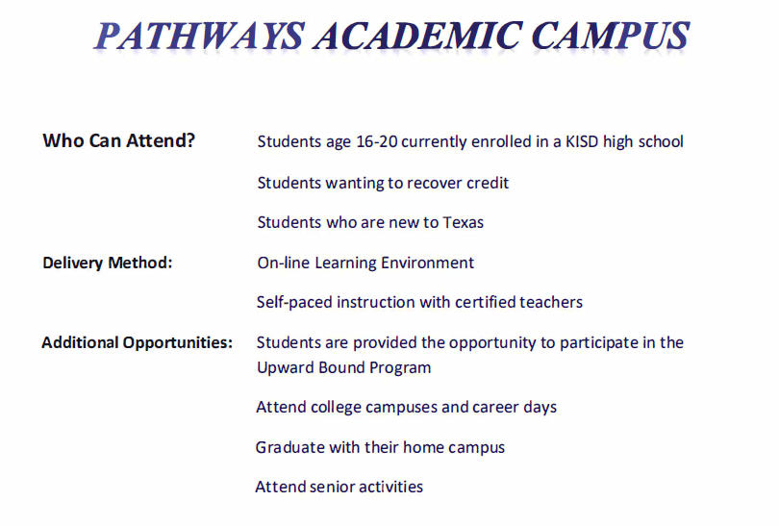
Edgenuity for all Class
Smaller Class sizes
Must be at least 16
Walk with HHHS at Graduation
Application Process
  Attendance
  Discipline
  Pick up applications outside Auditorium (today)
Turn in Application to room 1209 (Ms. Hampton)

Slide 17
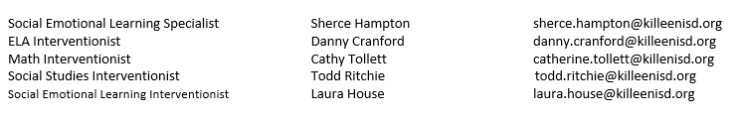
Intervention Support Team
Contact Information:
Please USE Remind for Edgenuity Courses

Slide 18
Questions
This Presentation will be Available Monday, September 11th, on the
HHHS Counseling Center Website at: https://bit.ly/hhhsintervention

